Slide 1
Test Strategy ,Test Scenario & Test Cases
TEAM MEMBERS:
PRASHANTH A BHOSALE
ABHISHEK KADAM
ADITI RAJARSHI
ASTHA JAIN
ARYAN SHARMA

Slide 2
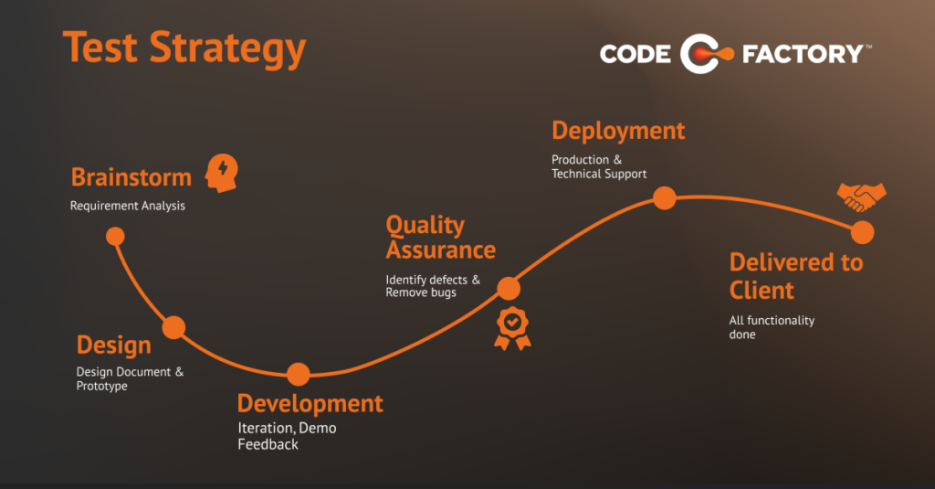
Test Strategy :
Test strategy is a set of guidelines that explains test design and determines how testing needs to be done
Test Strategy is done to create an understanding of the overall targets, approach, tools and timing of test activities to be done. It should clarify the major challenges and tasks of the test project.
Example-A Test Strategy includes details like “Individual modules are to be tested by the test team members ” In this case, who tests it does not matter – so it’s generic and the change in the team member does not have to be updated.

Slide 3
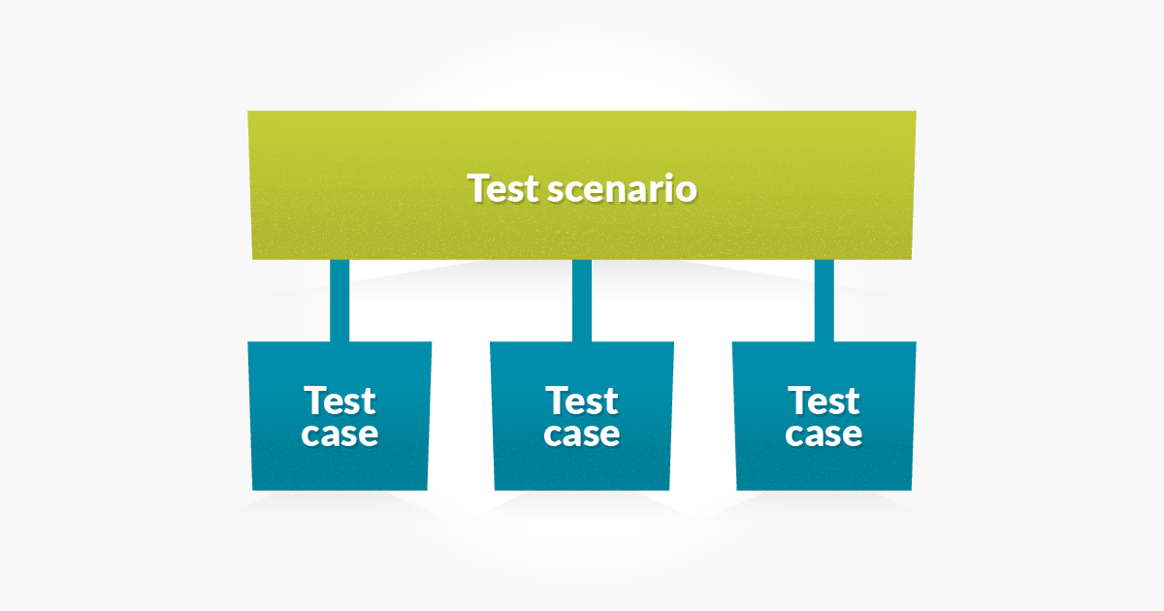
Test Scenario :
The main purpose of a test scenario is to check the entire system performance from the end-user point of view. A tester needs to put themselves in a user’s shoes. It gives them a clear idea of actual scenarios the software will have to cope with after release.
A test scenario is a set of manual or automated test cases that helps determine the positive and negative project characteristics. It provides an overview of what needs to be tested

Slide 4
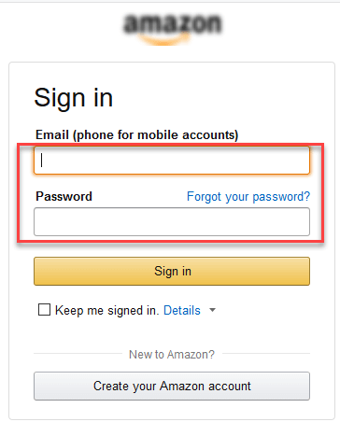
Example:-Test Scenario for E-commerce App:
Test Scenario 1: Check the Login Functionality as follows
Checking system behavior when valid email id and password is entered
Checking system behavior when invalid email id and valid password is entered.
Checking system behavior when valid email id and invalid password is entered.
Checking Forgot your password is working as expected
Checkng system behavior when “Keep me signed” is checked

Slide 5
Test Case :
A test case is a set of actions performed on a system to determine if it satisfies software requirements and also functions correctly as per customer demands. The process of writing a test case can also help reveal errors or defects within the system.
Functionality test cases
Performance test cases
Security test cases
Usability test cases
Unit test cases

Slide 6
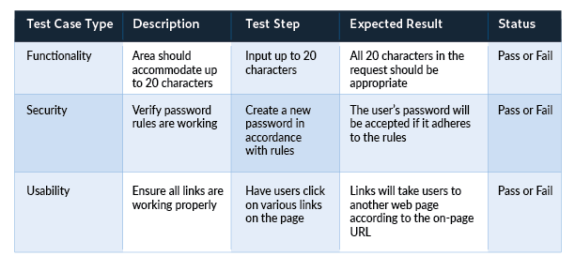
Example:-Test Cases for a Social Media App

Slide 7
THANK
YOU

